Slide 1
Analysis of Iowa Voting Trends to Predict Iowa’s 2020 Election Results
Cory Dahn Peng Jiang Gabriel Pagat

Slide 2
Problem description
Predict voting results for Iowa’s 2020 elections by county
Presidential
Congressional
Senatorial
Considered only Democrats and Republicans
Predicting voting habits can be useful when making political campaign decisions

Slide 3
Datasets
Election results from 1980 to 2018: https://www.kaggle.com/paultimothymooney/open-elections-data-usa
Election results for 2020: https://www.kaggle.com/unanimad/us-election-2020

Slide 4
Methodologies - Data Preparation
Most time spent preparing data
Needed to sort through, reorganize, and combine data from different files
Files with data were not uniform in scope or quantity of information

Slide 5
Methodologies - Programming Paradigm, System, and Services
Programming Paradigm
Python
Data sorting using pandas
Systems and Services
Jupyter Notebook
Scikit-Learn

Slide 6
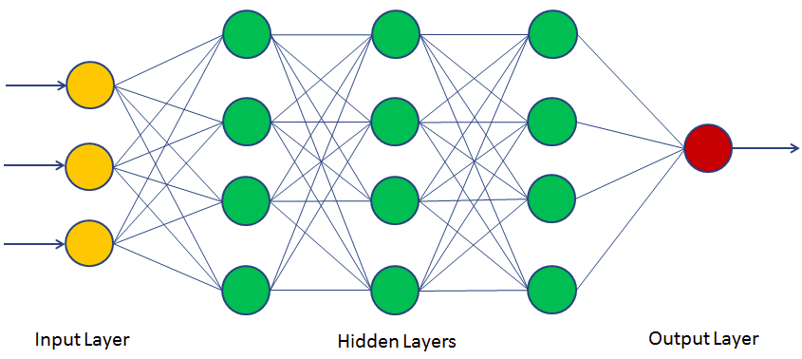
Methodologies - Neural Network Algorithm
Image credit: https://www.datacamp.com/community/tutorials/neural-network-models-r

Slide 7
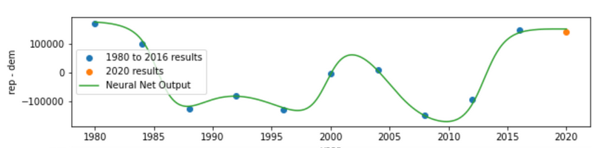
Neural Network Class - presidential

Slide 8
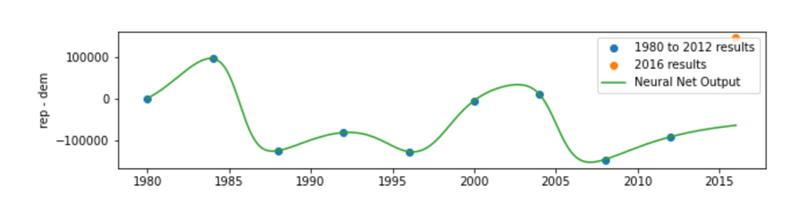
Neural Network Class - presidential

Slide 9
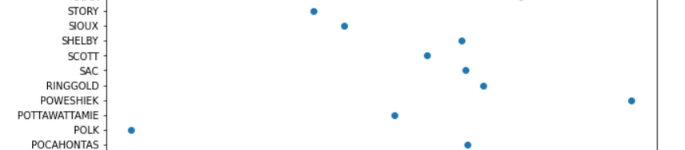
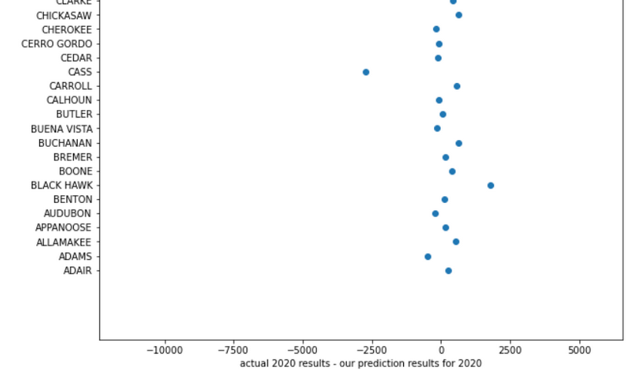
Neural Network Class - presidential

Slide 10
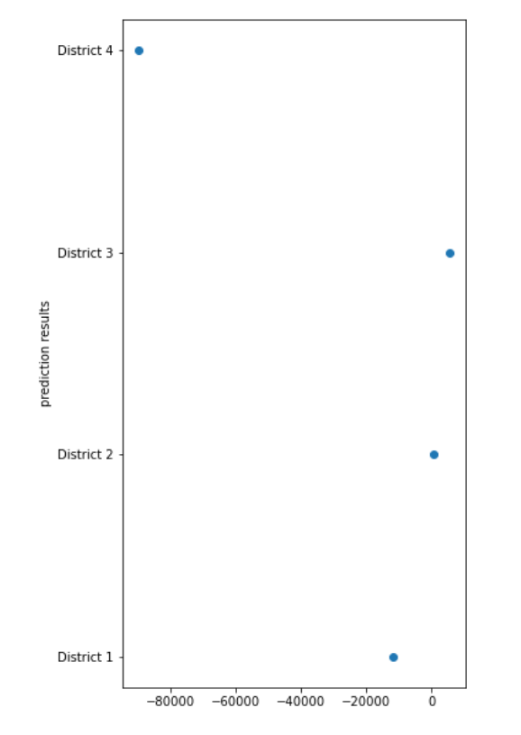
Neural Network Class - congressional

Slide 11
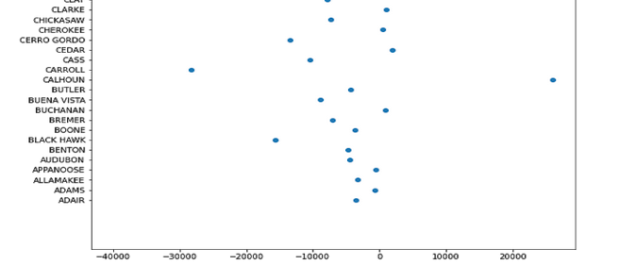
Neural Network Class - senatorial

Slide 12
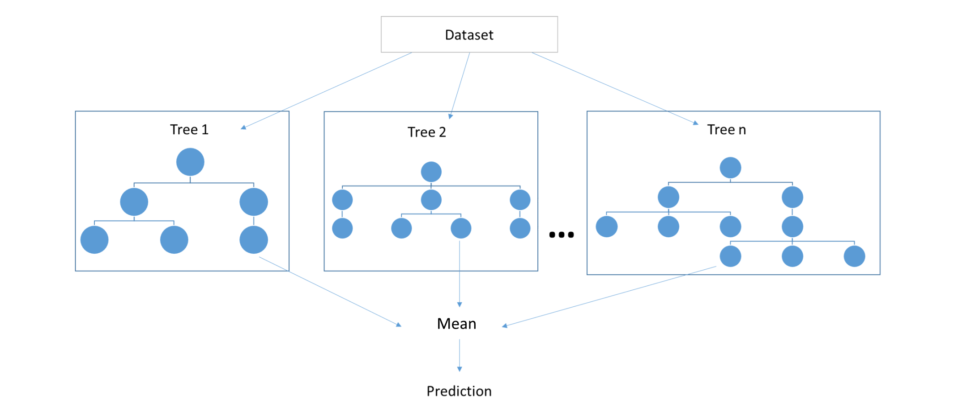
Methodologies - Random Forest Algorithm
Image credit: https://towardsdatascience.com/random-forests-and-decision-trees-from-scratch-in-python-3e4fa5ae4249

Slide 13

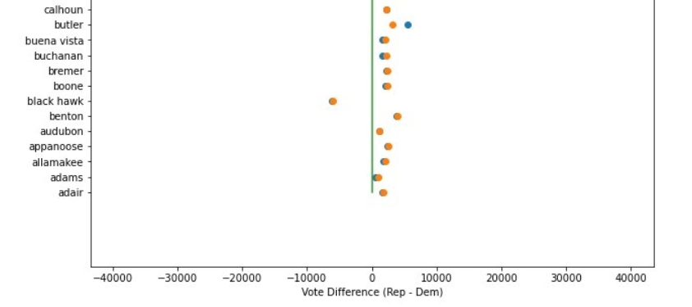
Random Forest - presidential

Slide 14
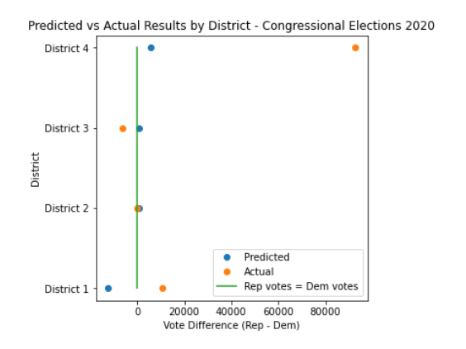
Random Forest - congressional

Slide 15

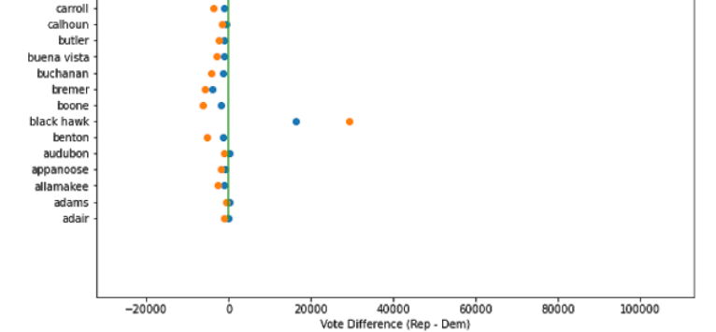
Random Forest - senatorial

Slide 16
Discussion of our analysis
Neural Networks vs Random Forest
Why our predictions are not very accurate

Slide 17
Conclusions
Summary
What we learned

Slide 18
Thank you so much

